Slide 1
Down and Dirty CSS
Day 5
January 26th, 2017

Slide 2
A Few Admin Items…

Slide 3
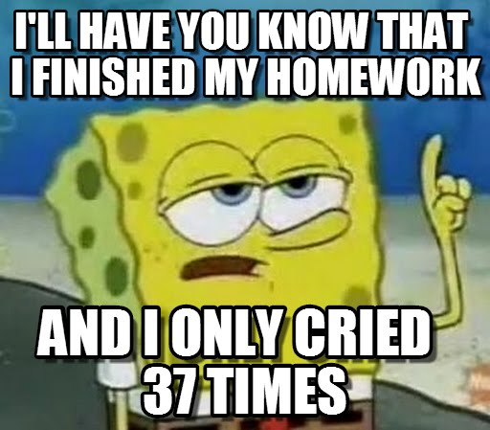
Homework is Due!
Don’t forget to submit both the GitHub and Heroku links!

Slide 4
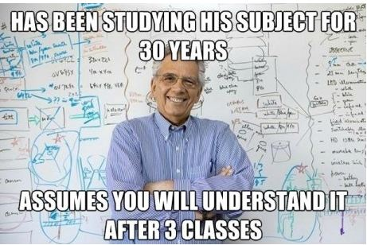
Feedback #1 – Pace is Fast!!!

Slide 5
Feedback #1 – Pace is Fast!!!
Here’s the reality, the pace of this program is FAST.
We could slow down and make it easier – but that wouldn’t prepare you to be developers right out of the program.
Take up the challenge. Try to retain as much as you can.
Then on your own time (after the program), go back and review the concepts you felt you needed a refresher on.
Don’t try to master every little detail.
Focus on the big picture and how to find what you need, when you need it.

Slide 6

Feedback #1 – Pace is Fast!!!
That said, as instructors and TAs, we are here to help.
Share your GitHub code as you run into issues. We can let you know if you’re going in the right (or wrong) direction.
Come to office hours! We can help go over old code, offer tips on homework, or just generally give you a pep talk.
Reach out to Student Success if you’d ever like to schedule a 1-on-1 meeting.

Slide 7

Feedback #2 – Books Please?
Code School offers some of the best online courses for HTML, CSS, JavaScript, Node, Express and Angular.

Slide 8
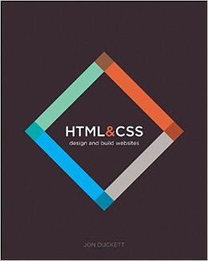
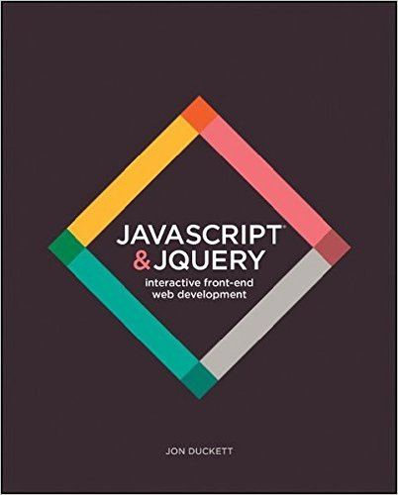
Feedback #2 – Books Please?
Jon Duckett’s books HTML & CSS and JavaScript & jQuery.
These are two of the clearest primers on their respective subjects. If you’re a “book-person,” these may be helpful texts.

Slide 9
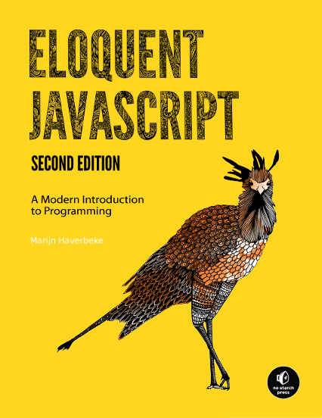
Feedback #2 – Books Please?
Eloquent JavaScript: a terrific, free book that goes through the fundamentals of JavaScript.
You can find it here: http://eloquentjavascript.net/

Slide 10

Feedback #3 – Homework is Hard

Slide 11
Feedback #3 – Homework is Hard
Going forward, Homework will be due Wednesday’s before midnight.
Generally speaking, expect homework to be challenging.
Make sure you’re leaving a solid block of time to put in.
If you find yourself working on assignment for over 2 hours without even a small amount of progress, let us know! Well, start by slacking for help on the class channel….
You don’t win points in life staring at a blank screen.

Slide 12
Today’s Class

Slide 13
Objectives
In today’s class, we’ll be introducing:
CSS Typography and Google Fonts
Pseudo-Classes
The Basics of Twitter Bootstrap

Slide 14
CSS Typography

Slide 15

Typography is Huge
Typography can play a huge role in the visual aesthetic and emotional identity of a webpage.

Slide 16
Typographic Properties
Line Height Distance between lines of text on a page (Golden Ratio of 1.5x font).
Font-Size Actual size of lettering. Should be at least 16 px on modern pages. https://www.smashingmagazine.com/2011/10/16-pixels-body-copy-anything-less-costly-mistake
Line Length Not a CSS property but rather a standard. Should be about 50-75 characters per line on a desktop . http://baymard.com/blog/line-length-readability
Letter Spacing Spacing between individual letters—try to avoid cramping.
Sans-Serif vs Serif Sans-serif are fonts sans their serifs—no tails. They’re easier to read online.

Slide 17

Line Height vs Fonts

Slide 18

Serif vs Sans Serif
Serif fonts include small lines attached to the end strokes of letters.
Sans-Serif (without serif) do not include such strokes.

Slide 19
> YOUR TURN!!
Assignment
01 – CSS Typography – Individual Effort – 10 Minutes
Instructions and file skeleton can be found in our class repo in the `in-class-activities/2.2_CSS` path.
May the Force be with you.

Slide 20
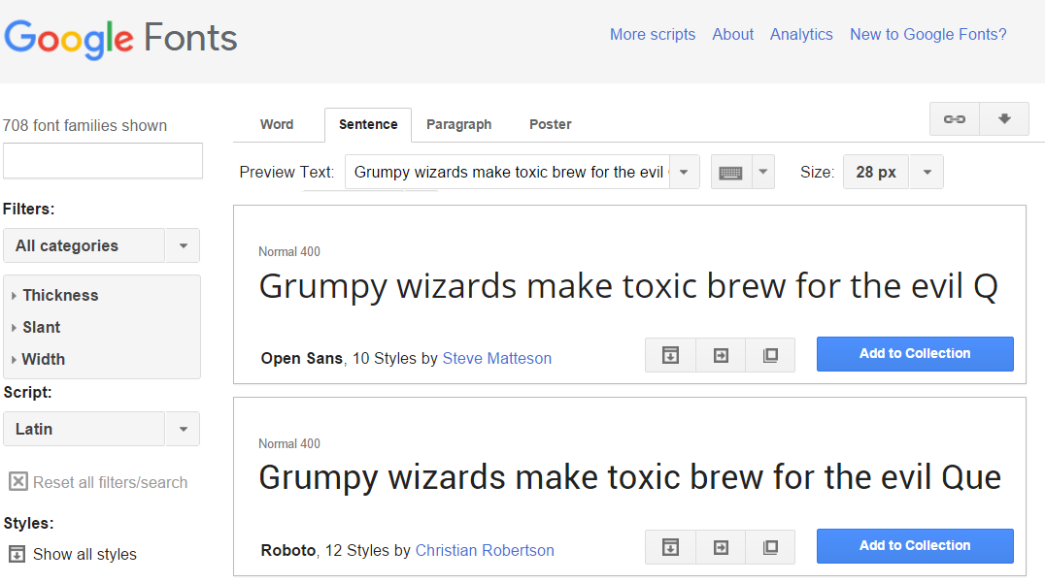
Google Fonts
You can easily incorporate Google’s custom fonts.

Slide 21
INSTRUCTOR DEMO!
Google Fonts

Slide 22
> YOUR TURN!!
Assignment:
02 – Custom Fonts Activity – Individual Effort – 10.75 Minutes
Instructions and file skeleton can be found in our class repo in the `in-class-activities/2.2_CSS` path.
Do. Or do not. There is no try.

Slide 23
Pseudo Styles

Slide 24
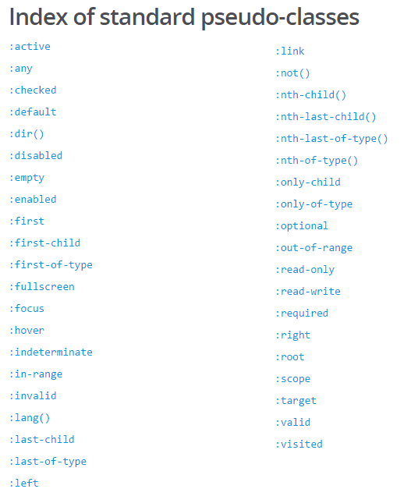
Pseudo Classes
CSS has keywords that can be added to selectors. These highlight the special states of the selected element.
Great example: CSS can hook onto the specific moment when a link is hovered over using the :hover pseudo-class.
Complete list of pseudo-classes found here: https://developer.mozilla.org/en-US/docs/Web/CSS/Pseudo-classes

Slide 25
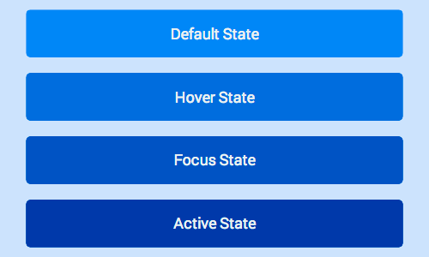
Button with Various States

Slide 26
INSTRUCTOR DEMO!
Instructor: Demo
(Button.html | 3-Pseudoclass)

Slide 27
> YOUR TURN!!
Assignment
03 – Pseudoclass – Individual Effort – 15 Minutes
Instructions and file skeleton can be found in our class repo in the `in-class-activities/2.2_CSS` path.
That’s no moon… it’s a space station!

Slide 28
Beyond CSS Hacking

Slide 29


Quick Refresher on HTML/CSS
HTML: Hypertext Markup Language – (Content)
CSS: Cascading Style Sheets – (Appearance)
HTML/CSS are the “languages of the web”. Together they define both the content and the aesthetics of a webpage – handling everything from the layouts, colors, fonts, and content placement. (Javascript is the third – handling logic, animation, etc.)

Slide 30


HTML vs HTML/CSS
HTML Alone
Like writing papers in “Notepad.”
Can only write unformatted text.
HTML / CSS
Like writing papers in Microsoft Word.
Can format text, page settings, alignment, etc. based on “highlighting” and menu options.

Slide 31
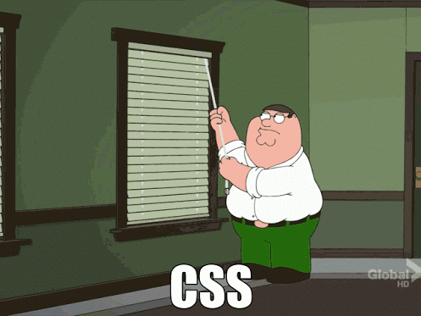
How You (Probably) Feel About CSS

Slide 32
A Revelation…
There is a better way!

Slide 33

Where’s the CSS? (Instructor Demo)

Slide 34
> YOUR TURN!!
Quick Activity:
04 – Where’s CSS – Partners – 5 Minutes
Instructions and file skeleton can be found in our class repo in the `in-class-activities/2.2_CSS` path.
Hit it Chewie!!!

Slide 35


Powered by Bootstrap
External CSS Link
Pre-Defined CSS Class (ex: “Jumbotron”)

Slide 36
Powered by Bootstrap
class=“jumbotron”

Slide 37

Big Deal!!!
Using Bootstrap,
we have PRE-DEFINED CSS Styles.

Slide 38
> YOUR TURN!!
Quick Activity: 5 Minutes Maximum
Turn to the person next to you and celebrate this together.
Then discuss the concept of Bootstrap to confirm that you both understand why you are celebrating.
We will stop by and eavesdrop ☺
Hint: You should be explaining why is Bootstrap’s “pre-defined” CSS a big deal.

Slide 39
What is Bootstrap?

Slide 40

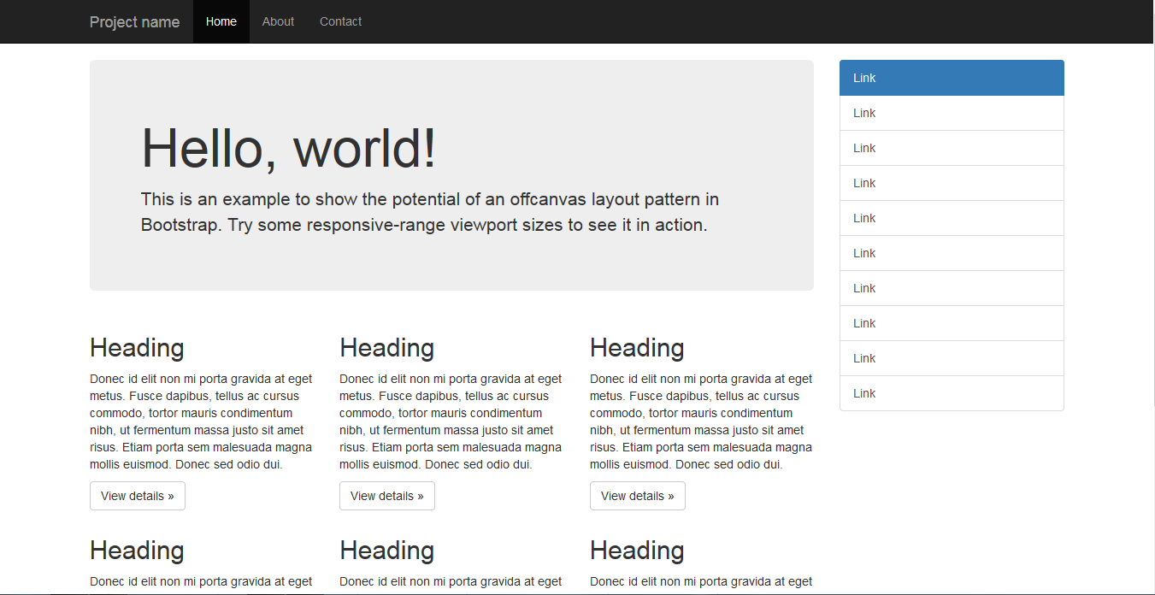
Bootstrap Definition
Twitter Bootstrap is a free collection of tools for creating websites and web applications.
It comes with a pre-built design template for typography, forms, buttons, navigation, UI elements and JavaScript.
Documentation here: http://getbootstrap.com/

Slide 41

Why Use Bootstrap?
Reason #1: UI Kit
Familiarize yourself with the UI features it offers via the documentation.
Once Bootstrap is active, you can simply copy snippets from the documentation to save yourself major time of creating elements yourself.

Slide 42

Why Use Bootstrap?
Reason #2: Mobile Responsiveness
One of the most compelling reasons to use Bootstrap is the default mobile-responsive quality it provides.
This means that your website will look “good” automatically when viewed on screens ranging from monitors to tablets to phones.

Slide 43

HTML / CSS / Bootstrap Analogy
HTML Alone
Like writing papers in “Notepad.”
Can only write unformatted text.
HTML / CSS
Like writing papers in Microsoft Word.
Can format text, page settings, alignment, etc. based on “highlighting” and menu options.
HTML / CSS & Bootstrap
Like writing papers in Microsoft Word with a prebuilt template.
You can still customize, but now have a pre-built style and aesthetic look.

Slide 44
Key Bootstrap Features

Slide 45
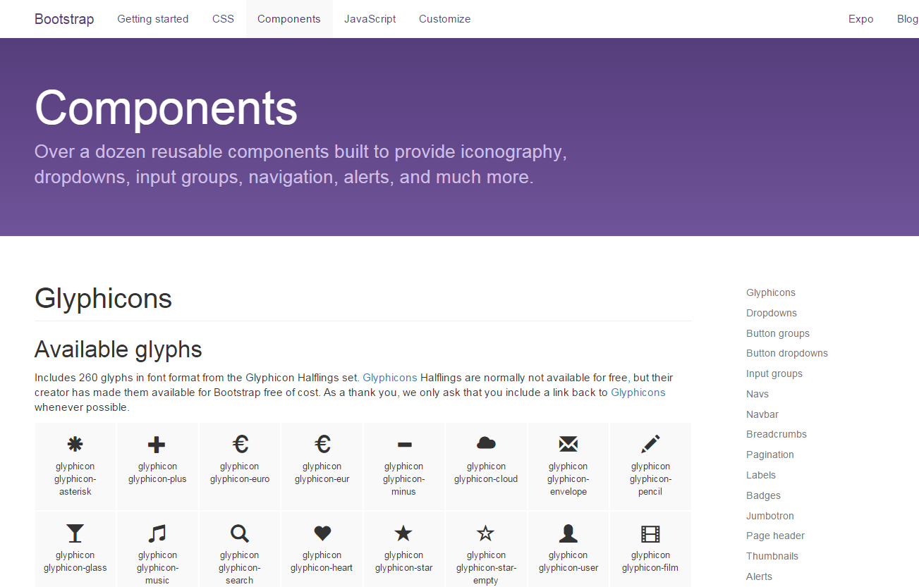
Bootstrap Components
Bootstrap offers a wide range of components that you should consider including in your next web projects. Flip through the documentation and incorporate elements you see fit.

Slide 46

Bootstrap Nav Bars
Example:

Slide 47
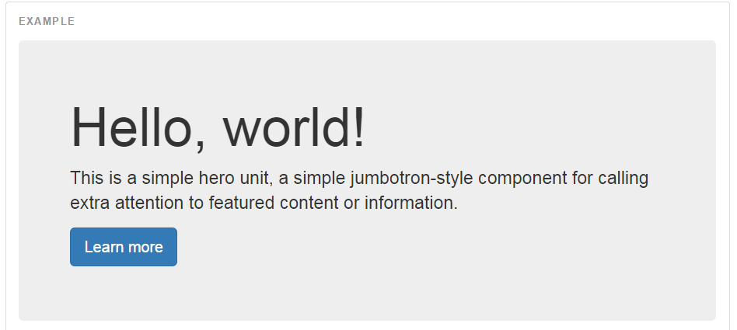

Bootstrap Jumbotron
Example:

Slide 48
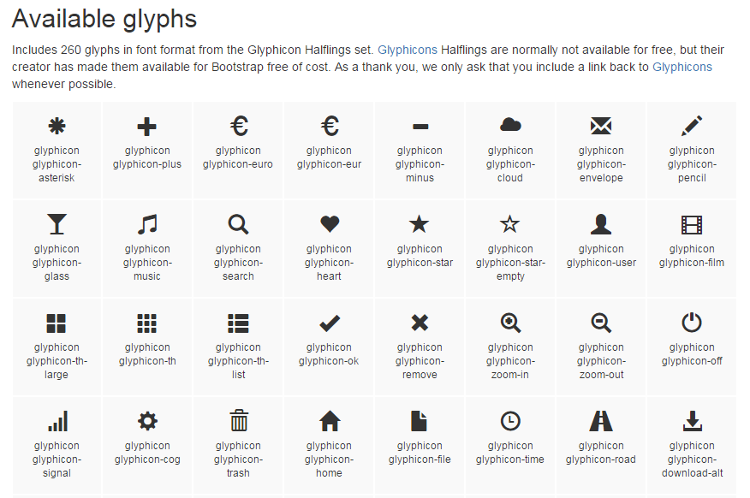
Bootstrap Glyphs
Example:

Slide 49


Bootstrap Table
Example:

Slide 50


Bootstrap Form
Example:

Slide 51
INSTRUCTOR DEMO!
Instructor: Demo
(BootstrapButtons.html | 5-BootstrapDemo)

Slide 52
> YOUR TURN!!
Activity:
05 – Bootstrap Components – Partners – 15 Minutes
Instructions and file skeleton can be found in our class repo in the `in-class-activities/2.2_CSS` path.
I find your lack of faith disturbing…

Slide 53
Takeaways

Slide 54
Takeaways
By the end of class you should be able to:
Offer a loose definition of “typography” and a few CSS properties for styling it.
Offer a practical example of using pseudo-classes.
Understand generally what Twitter Bootstrap is and why pre-defined CSS frameworks are powerful.
Know how to incorporate the Twitter Bootstrap style library into your website.

Slide 55

Next Class… Layout Building!

Slide 56
Questions?

Slide 57
Homework #2

